Slide 1


Customer Churn Prediction in Telecom Industry
Ravindra Babu Neralla
Bellevue University
DSC680 – Project 1

Slide 2

Introduction
Customer churn is a major problem and one of the most important concern for every company. Retaining an existing customer is many times more effective than gaining new customers. Companies usually have a greater focus on customer acquisition and keep retention as a secondary priority. However, it can cost five times more to attract a new customer than it does to retain an existing one. Increasing customer retention rates by 5% can increase profits by 25% to 95%, according to research done by Bain & Company. Generally, people only switch to a different company only when the service is not to the level of expectation in one or the other factor when compared to competitors, more than getting attracted to the specials and offers which are offered by the other companies. It is pretty common to hear people express frustration with some aspect of their communications provider — be it convoluted billing, unwanted marketing emails, hard-to-navigate customer service or high plan prices. As the number of peoples who use a phone or a telecom product does not increase in huge volume, any company looking to improve the profits is trying to attract other company customers. At the same time retaining existing customers is very important. As retaining a current customer is ten times more productive than gaining a new one.

Slide 3
Objective
As customer churn directly effects the revenues of the companies, companies are seeking to develop means to predict potential customer to churn. Therefore, finding factors that increase customer churn is important to take necessary actions to reduce this churn and retain the customers.
Scope
Scope of the project is to use the sample dataset from Kaggle, which shows several categories of customers and also some influencing factors causing the customer churn in the telecom industry to perform customer segmentation and identify a pattern which influence the customer churn. Implement supervised machine learning process to achieve the goal.

Slide 4
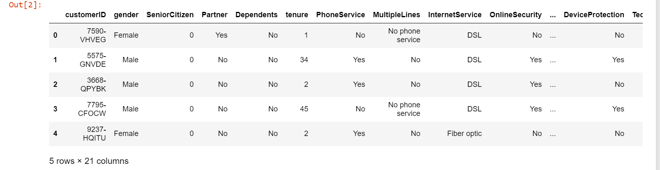
Data
The dataset, I am planning to work on in this project is Telco Customer Churn. Dataset consists of 21 variables with 7043 observations. Each Observation in the dataset represents a customer. Below is the detailed list of variables.
customerID
gender
SeniorCitizen
Partner
Dependents
tenure
PhoneService
MultipleLines
InternetService
OnlineSecurity
OnlineBackup
DeviceProtectio
TechSupport
StreamingTV
15. StreamingMovies
16. Contract
17. PaperlessBilling
18. PaymentMethod
19. MonthlyCharges
20. TotalCharges
21. Churn

Slide 5

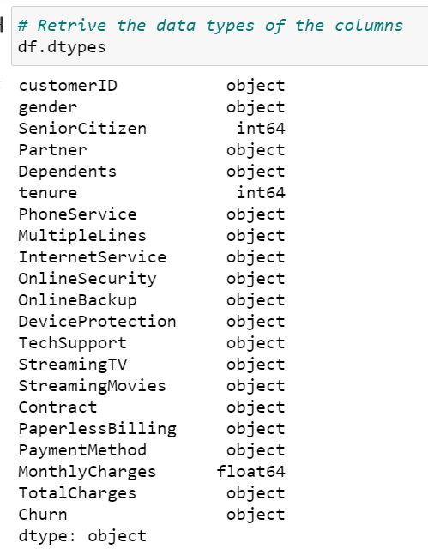
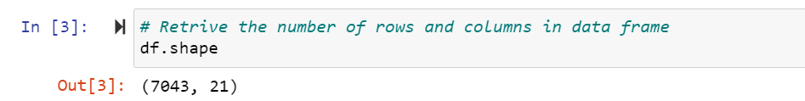
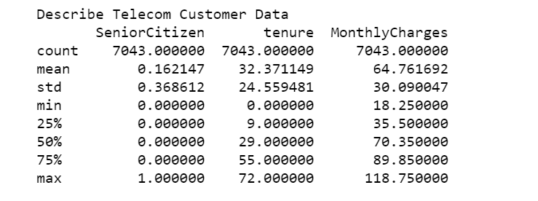
Basic Characteristics
Observations:
Only 3 variables are numeric and rest all are categorical values.
There are total 7043 observations

Slide 6
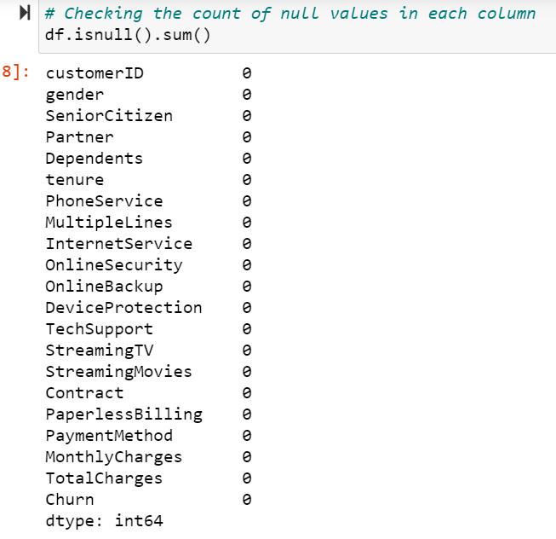
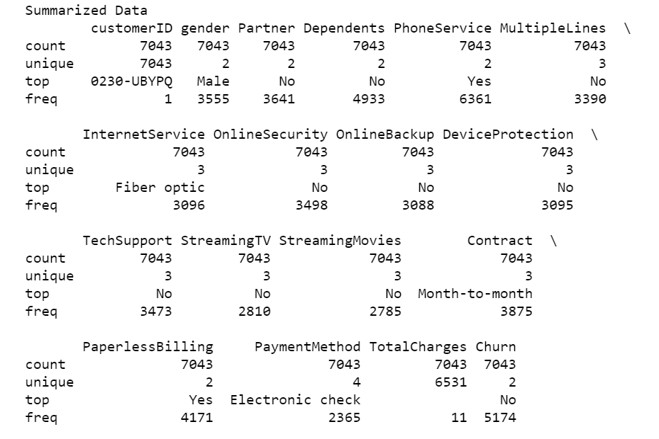
Perform exploratory data analysis on the dataset:
Observation is that, there is no null values in any of the columns and statistics on individual variables in dataset

Slide 7
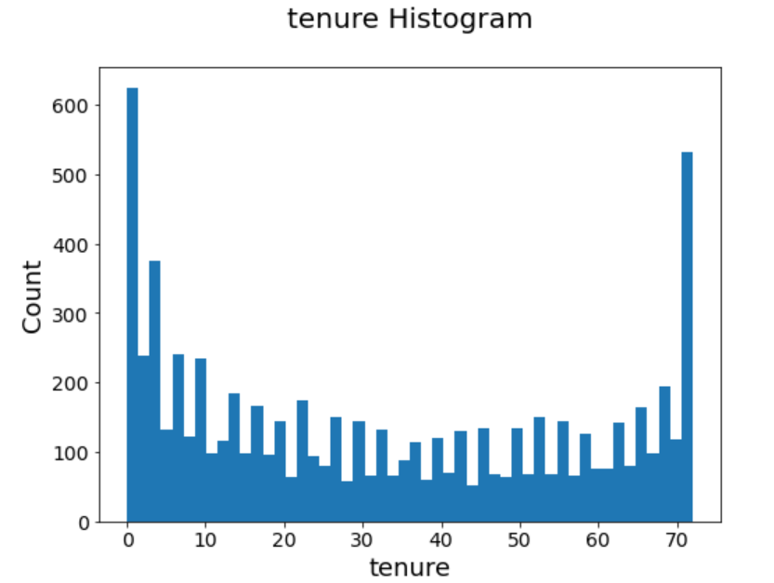
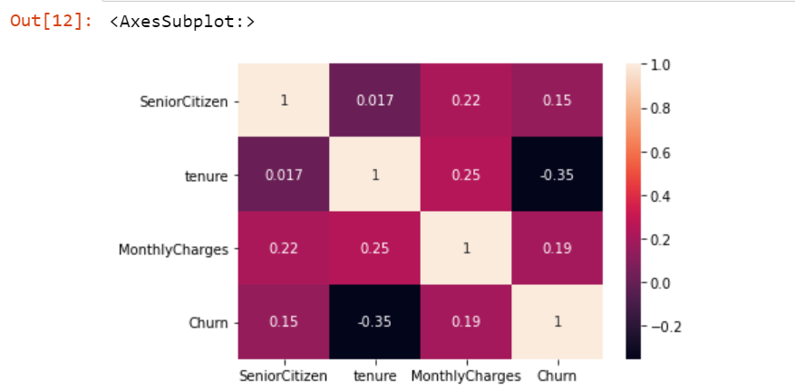
Numerical Variables Analysis
Observation is that, “tenure” variable has a better correlation with comparison to the output variable “churn”.
We built a histogram to see the spread of the data.

Slide 8
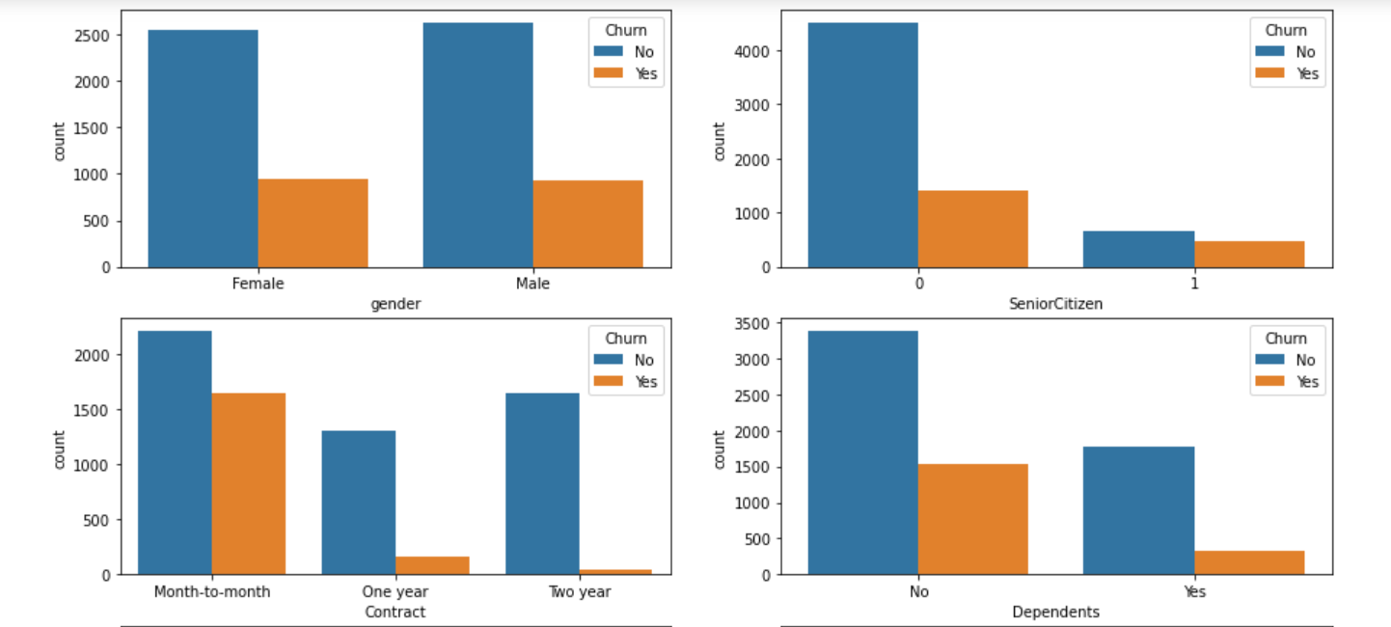
Categorical variables Analysis:
Variable gender has both Male and Female members and has equal customer churn.
Customer Churn is low in SeniorCitizen category.
Churn is more when the Contract is month-to-month.
Customers with no dependents tends to churn low.

Slide 9
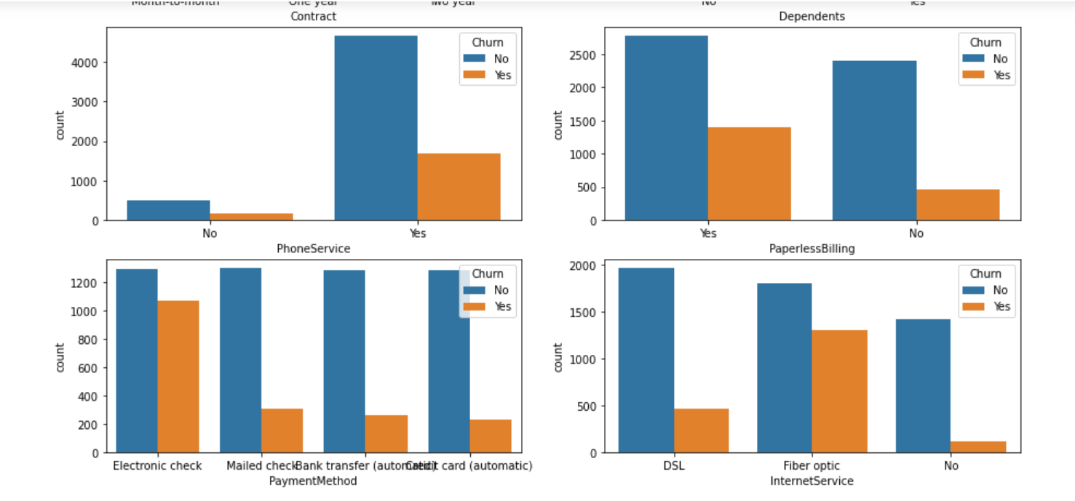
Categorical variables Analysis:
Customers with “Phone Service” has higher Customer churn.
Customers who opted for “Paperless Billing” has higher Customer churn.
Customers who generally pay with ‘Electronic Check’ has higher Customer churn.
Customers who are using ‘Fiber Optic’ as “Internet Service” has higher Customer churn.

Slide 10
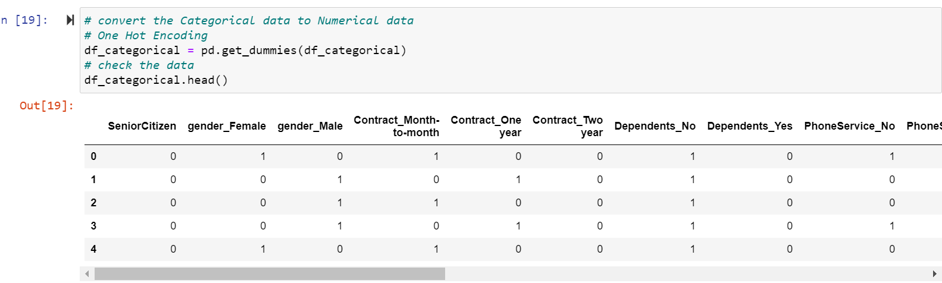
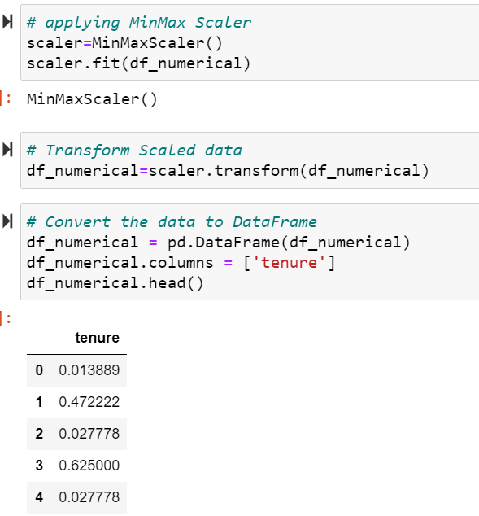
Apply Encoding methods: .
Applied Encoding method to convert Categorical variables to numerical values.
Applied Scalar method to convert the Numerical variable to reduce the value and maintain consistent value range.

Slide 11
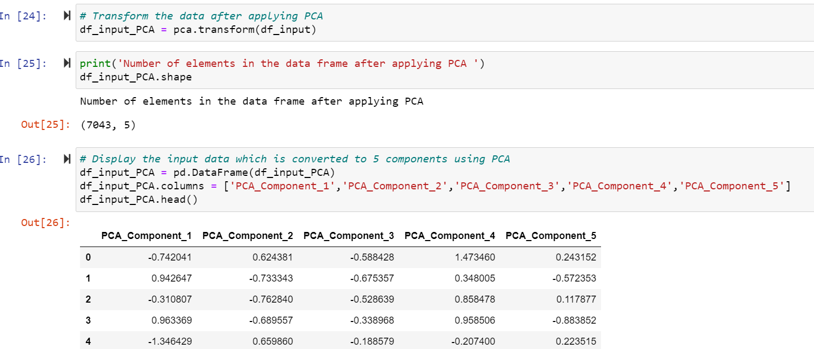
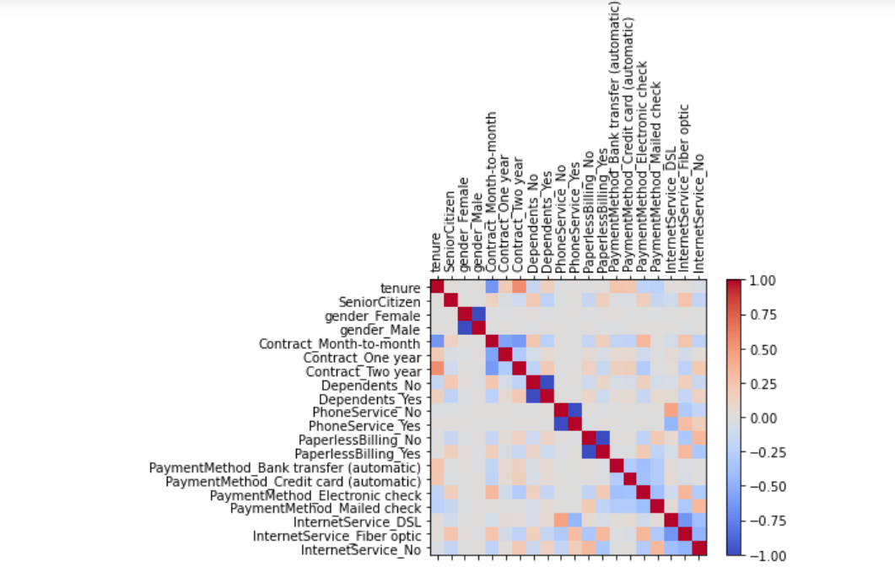
Reduce Number of Dimensions
After converting categorical variables to numeric values, the number of input variables have increased.
Applied PCA method to reduce the number of variables to 5.

Slide 12
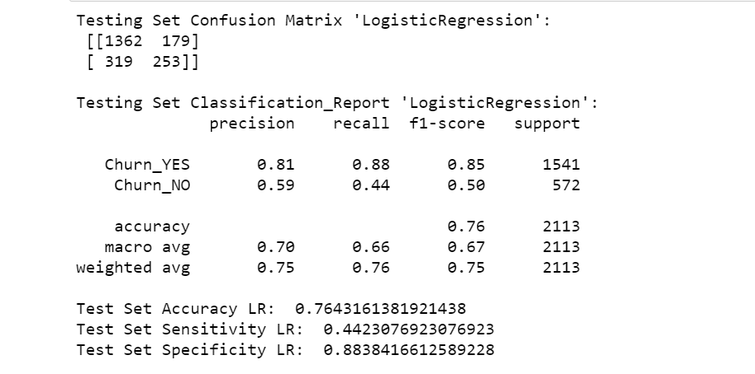
Logistic Regression
Applied Machine Learning model, “Logistic Regression” on the training data set and evaluated the performance of the model using test set.
Accuracy in Logistic Regression model is 76%.

Slide 13
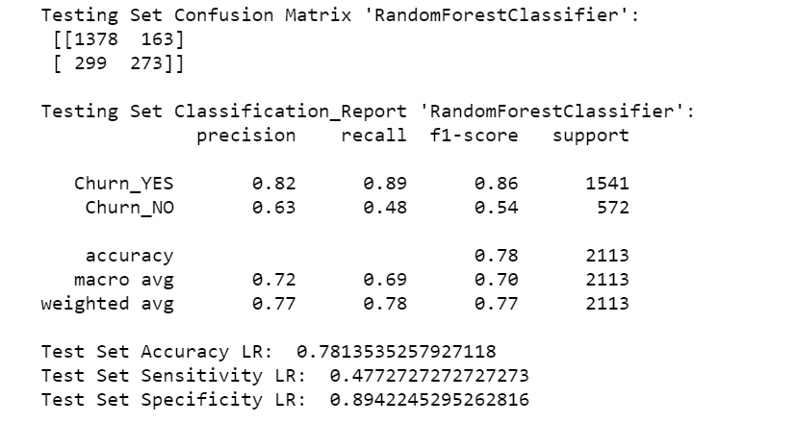
RandomForest
Applied Machine Learning model, “Random Forest” on the training data set and evaluated the performance of the model using test set.
Accuracy in Random Forest model is 78%.

Slide 14
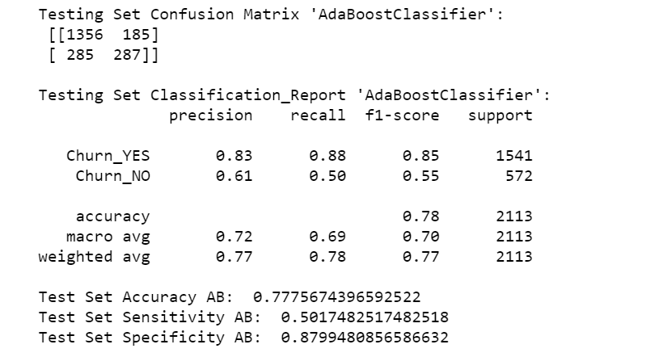
ADABoost Classifer
Applied Machine Learning model, “ADA Boost” on the training data set and evaluated the performance of the model using test set.
Accuracy in ADA Boost model is 78%.

Slide 15
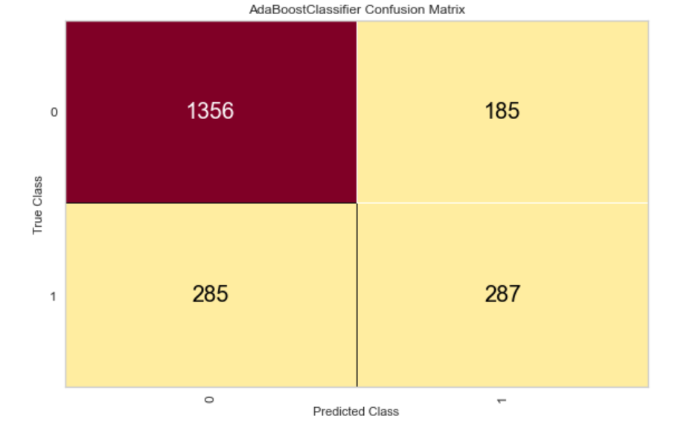
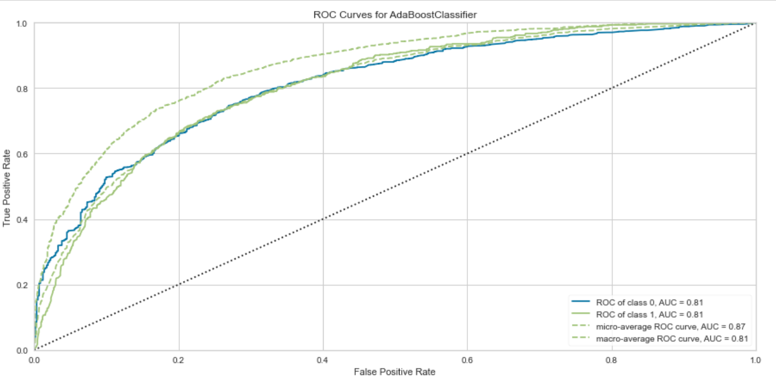
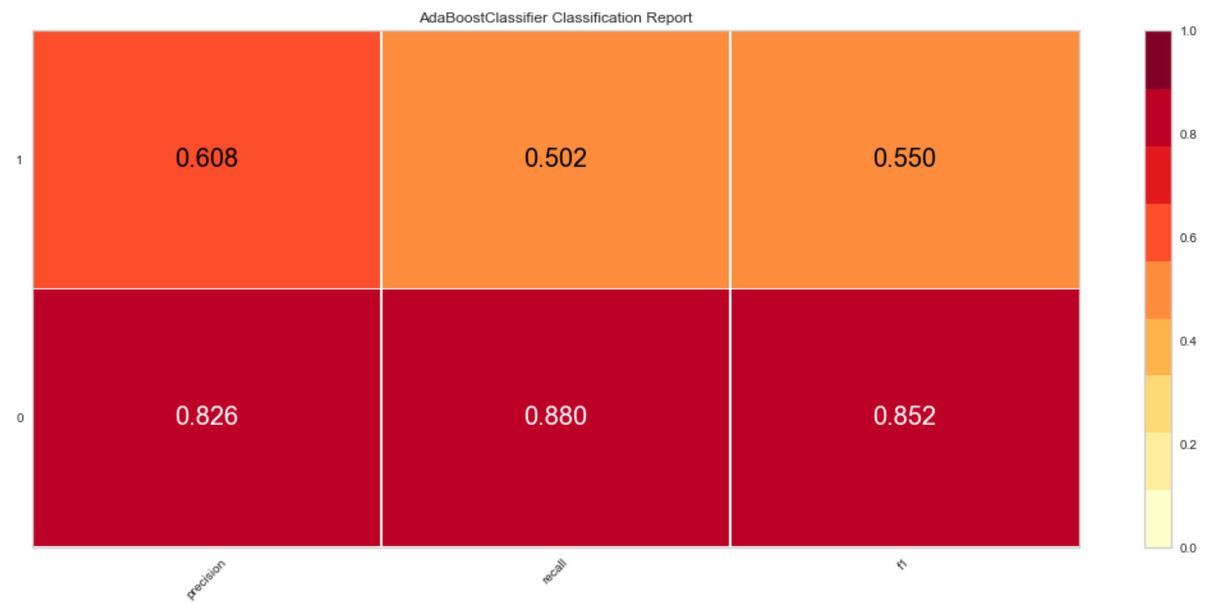
Evaluate Model Performance
Using Confusion matrix, evaluated the results and calculated ‘Precision , Recall and f1 score.
Built ROC curve and observed the AUC (area under curve) values as 0.81 .

Slide 16
References:
[1]: How Costly Is Customer Churn in the Telecom Industry? - EBR
[2]: Customer Churn in Telecom Segment - Curi
https://towardsdatascience.com/customer-churn-in-telecom-segment-5e49356f39e5
[3]: Telco Customer Churn - BlastChar
https://www.kaggle.com/blastchar/telco-customer-churn
[4]: PCA using Python (scikit-learn) - Galarnyk
https://towardsdatascience.com/pca-using-python-scikit-learn-e653f8989e60
[5]: Churn Reduction in Telecom Industry – Arthur Middleton Hughes
http://www.dbmarketing.com/telecom/churnreduction.html

